Slide 1
CS1702: Computational Thinking Week 7: Binary Tree
Xuhua Ding
(xhding@smu.edu.sg)
AY2019/20 Term 2

Slide 2

Road Map
Algorithm Design and Analysis
(Weeks 1 - 5)
Fundamental Data Structures
Week 6: Linear data structures (stack, queue)
Week 7: Hierarchical data structure (binary tree)
Week 9: Networked data structure (graph)
This week
Computational Intractability and Heuristic Reasoning
(Weeks 10 - 13)

Slide 3

Good Things Come in Pairs
Modeling hierarchical relationships using binary trees
Tree
Binary Tree
Binary Search Tree

Slide 4
Reference
Handout on Fundamental Data Structures Chapter 2

Slide 5
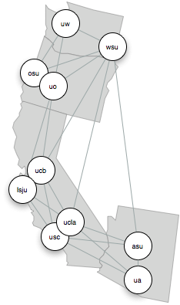
Non-linear Data Structures
Representing not just the data elements, but also their relationships
Complex relationships
not just “before and after”
Two types:
Trees
hierarchical
Graphs
non-hierarchical
.com
bbc.com
google.com
mail.google.com
news.google.com

Slide 6
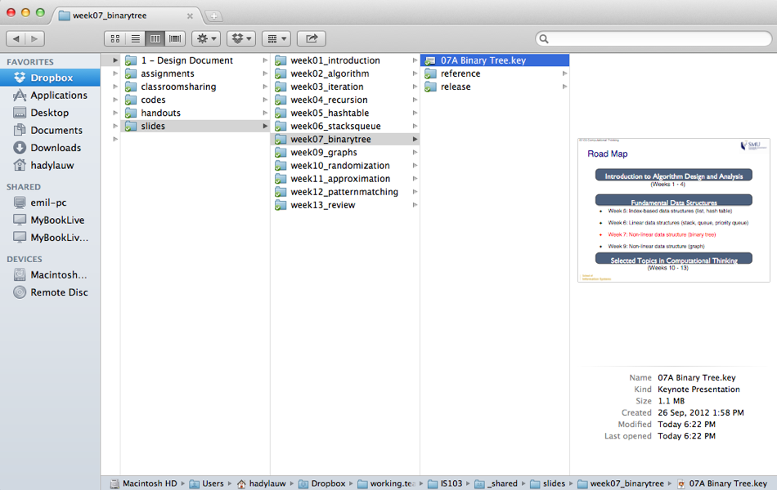
Example: File Directory Structure

Slide 7

Example: Organizational Chart
http://tech.fortune.cnn.com/2011/08/29/rethinking-apples-org-chart/

Slide 8
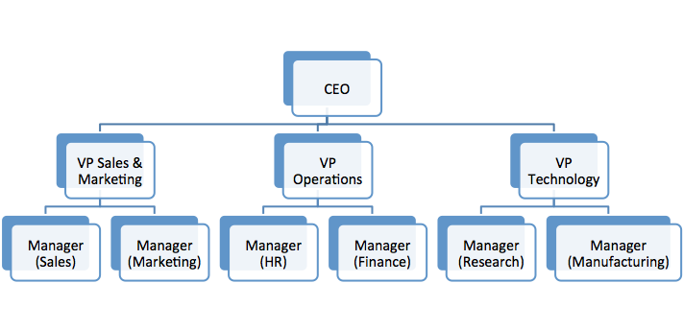
Recursive Definition of a Tree
A tree consists of:
a root node n
zero or more sub-trees, each rooted at a child of n
root node
subtree 1
subtree 3
subtree 2

Slide 9
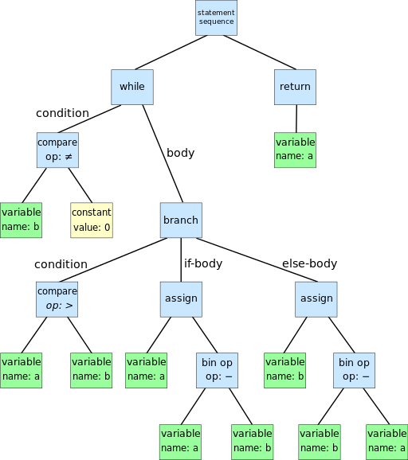
Why is Binary Tree Important?
Heaps: Used in implementing efficient priority-queues.
Huffman Coding Tree: Commonly used in data compression methods, such as ZIP, JPEG, and MP3.
Syntax Tree: How computer interprets your programs, and how calculators interprets your arithmetic expressions.
while b ≠ 0
if a > b
a := a − b
else
b := b − a
end
end
return a

Slide 10
Relationships
Parent and child
a parent node is directly related to a number of children nodes
e.g., CEO is the parent of the three VP-level nodes
Ancestor and descendant
an ancestor is indirectly related to a number of descendant nodes through transitive parent-child relationships
e.g., CEO is the ancestor of all the Manager-level nodes
Siblings
children nodes of the same parent node
e.g., Manager (Sales) and Manager (Marketing) are siblings

Slide 11
Level and Height
The root node is at level 1 of the tree
Children of the root node are at level 2, and so on
Height of the tree is the number of levels a tree has.
An empty tree has a height of 0

Slide 12
Binary Tree
A tree where each parent can have at most two children.
Root
Internal Nodes
Leaf Nodes

Slide 13
Types of Binary Tree
Full Binary Tree:
Each node has exactly zero or two children.
Complete Binary Tree:
Every level, except possibly the deepest, is completely filled. At depth h, the height of the tree, all nodes must be as far left as possible.
NOT a complete tree

Slide 14
Types of Binary Tree
Perfect Binary Tree:
All leaf nodes are at the same depth; all internal nodes have degree 2.
How many nodes does a perfect binary tree with depth h have?

Slide 15
Implementation of Binary Tree
Binary tree is composed of independent “nodes” linked together.
Each node contains data it stores and 2 references to the left and right children (nil if no child follows).
…
…

Slide 16
Node Object: Operations (For Your Reference)
left / right
returns the current left / right child of this node
value
value currently stored in this node; can be any object
new(value)
creates a new node object with the specified value
setLeft(node) / setRight(node)
set the input node to be the left / right child of this node
delLeft / delRight
removes the current left / right child of this node

Slide 17
BinaryTree Object: Operations (For Your Reference)
root
returns the root node
noOfNodes
returns the number of nodes in the tree
heightOfTree
returns the height of the tree
new
creates a new binary tree object
setRoot(node)
sets the input node to be the root node of this tree
isEmpty?

Slide 18
Traversals of a Binary Tree
“Walk through” the tree by visiting each node once
e.g., searching for a particular node
Three common methods of traversal:
preorder
visiting a parent first, before visiting the left child and the right child
inorder
visiting the parent after the left child, but before the right child
postorder
visiting the parent after visiting the left and right children
All three can be defined recursively

Slide 19
Traversal: preorder
def preorder_traverse(node):
if node != None:
visit(node)
preorder_traverse(node.left)
preorder_traverse(node.right)

Slide 20
Traversal: inorder
def inorder_traverse(node):
if node != None:
inorder_traverse(node.left)
visit(node)
inorder_traverse(node.right)

Slide 21
Traversal: postorder
def postorder_traverse(node):
if node != None:
postorder_traverse(node.left)
postorder_traverse(node.right)
visit(node)

Slide 22
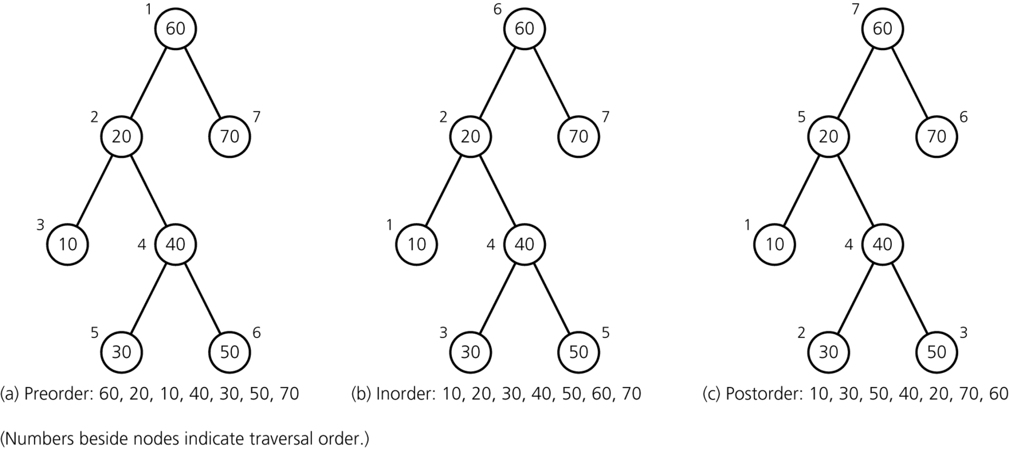
Traversal of a Binary Tree
a) preorder; b) inorder; c) postorder
Animation: http://www.qmatica.com/DataStructures/Trees/AVL/AVLTree.html

Slide 23
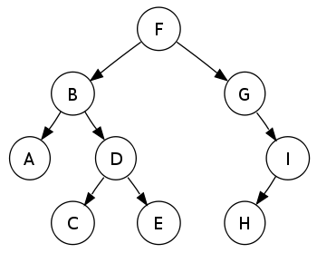
Practice Traversal #1
http://en.wikipedia.org/wiki/Tree_traversal
Preorder?
Inorder?
Postorder?
Please watch the video file name: traversal.mov

Slide 24
Binary Search Tree
Definition of a binary search tree:
root node r has a value larger than all the nodes in its left subtree and smaller than all the nodes in its right subtree
its left and right subtrees are also binary search trees
The node values are the search keys.

Slide 25
Example: Binary Search Tree

Slide 26
Example: Binary Search Tree

Slide 27
BinarySearchTree Object: Operations
Besides operations in BinaryTree object, BinarySearchTree has the following additional operations:
search(key)
searches for a node with value == key, and returns the node if found
insert(key)
inserts a new node with value set to the given key
remove(key)
removes an existing node with value == key

Slide 28
Searching a Binary Search Tree
Start from the root node
if the root node has the value == key, return the root node
if the root node has value > key, recursively search the left subtree
if the root node has value < key, recursively search the right subtree
else, return nil

Slide 29
Helper Method searchbst
def searchbst(root, key):
if root.value == key:
return root
elif root.left != None and root.value > key:
return searchbst(root.left, key)
elif root.right != None and root.value < key:
return searchbst(root.right, key)
else:
return None
Complexity?

Slide 30
Inserting a Node into a Binary Search Tree
Insert the new node where we would have expected to find it
the exact position where searching the current tree would fail

Slide 31
def insertbst(root, key):
if root.value == key:
return root
if root.value > key:
if root.left != None:
return insertbst(root.left, key)
else:
node = Node(key)
root.setLeft(node)
return node
else:
if root.right != None:
return insertbst(root.right, key)
else:
node = Node(key)
root.setRight(node)
return node

Slide 32
Removing a Node from Binary Search Tree
Take care to keep the resulting binary search tree in proper order
Traverse to find the node
Need to consider three scenarios:
the node to be removed is a leaf node
the node to be removed has one child
the node to be removed has two children

Slide 33
Removing a Node from Binary Search Tree
Methods for deleting node n
If n is a leaf
Set n’s parent’s pointer to nil
If n has only one child
Let n’s parent adopt n’s child
If n has two children
Remove the biggest node from n’s left subtree and use it to replace n, Or remove the smallest node from n’s right subtree and use it to replace n
replace n with one of its neighbors in in-order traversal
http://en.wikibooks.org/wiki/Data_Structures/All_Chapters#Deleting_an_item_from_a_binary_search_tree
4
to
remove
3
2
6
2
6
1
1
3
5
7
1
3
5
7

Slide 34
Efficiency of Binary Search Tree Operations
The maximum number of comparisons for a search, insertion, or deletion operation is the height of the tree
What is the maximum and minimum heights of a binary search tree of n nodes?
The shape of a binary search tree determines the efficiency of its operations

Slide 35
Summary
Trees are data structures that capture hierarchical relationships
Binary tree:
every parent can have at most two children
Traversal: walking through every node in a tree
preorder: visiting each parent before visiting its left and right children
inorder: visiting each parent in between visiting left and right children
postorder: visiting each parent after visiting left and right children
Binary search tree:
more efficient search by keeping the nodes ordered
searching only requires visiting one node at every level
insertion and removal have to take care to preserve the order

Slide 36
Road Map
Algorithm Design and Analysis
(Weeks 1 - 5)
Fundamental Data Structures
Week 6: Linear data structures (stack, queue)
Week 7: Hierarchical data structure (binary tree)
Week 9: Networked data structure (graph)
Next week
Computational Intractability and Heuristic Reasoning
(Weeks 10 - 13)

